Slide 1
Chapter 2
Process Management
-Manya Gidwani

Slide 2
Process Scheduling
Maximize CPU use, quickly switch processes onto CPU for time sharing
Process scheduler selects among available processes for next execution on CPU
Maintains scheduling queues of processes
Job queue – set of all processes in the system
Ready queue – set of all processes residing in main memory, ready and waiting to execute
Device queues – set of processes waiting for an I/O device
Processes migrate among the various queues

Slide 3
process scheduler
The objective of multiprogramming is to have some process running at all times, to maximize CPU utilization.
The objective of time sharing is to switch the CPU among processes so frequently that users can interact with each program while it is running.
To meet these objectives, the process scheduler selects an available process (possibly from a set of several available processes) for program execution on the CPU.
For a single-processor system, there will never be more than one running process. If there are more processes, the rest will have to wait until the CPU is free and can be rescheduled.

Slide 4
Procedure
As processes enter the system, they are put into a job queue, which consists of all processes in the system.
The processes that are residing in main memory. And are ready and waiting to execute are kept on a list called the ready queue.
Refer: queing diagram

Slide 5
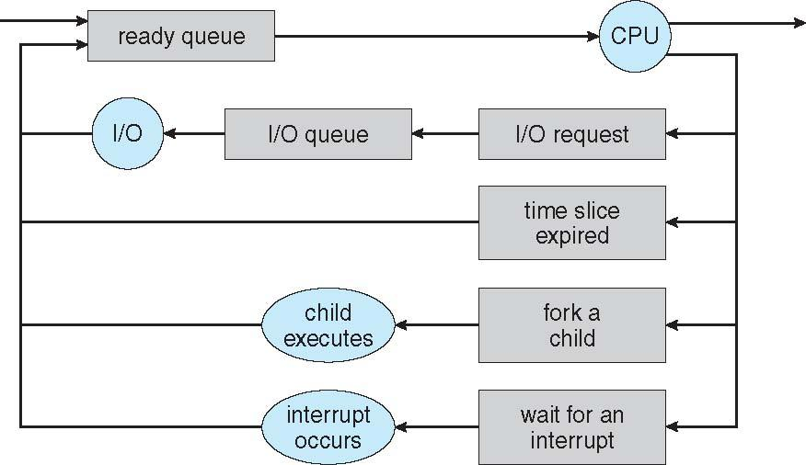
Representation of Process Scheduling

Slide 6
A common representation of process scheduling is a queueing diagram,
Each rectangular box represents a queue. Two types of queues are present: the ready queue and a set of device queues. The circles represent the resources that serve the queues, and the arrows indicate the flow of processes in the system. A new process is initially put in the ready queue. It waits there until it is selected for execution, or is dispatched. Once the process is allocated the CPU and is executing, one of several events could occur:
The process could issue an I/0 request and then be placed in an I/0 queue.
The process could create a new subprocess and wait for the subprocess's termination.
The process could be removed forcibly from the CPU, as a result of an
interrupt, and be put back in the ready queue.

Slide 7
Schedulers
A process migrates among the various scheduling queues throughout its lifetime. The operating system must select, for scheduling purposes, processes from these queues in some fashion. The selection process is carried out by the appropriate scheduler.
Long-term scheduler (or job scheduler) – selects which processes should be brought into the ready queue
Short-term scheduler (or CPU scheduler) – selects which process should be executed next and allocates CPU
Sometimes the only scheduler in a system

Slide 8
Schedulers (Cont.)
Short-term scheduler is invoked very frequently (milliseconds) ⇒ (must be fast)
Long-term scheduler is invoked very infrequently (seconds, minutes) ⇒ (may be slow)
The long-term scheduler controls the degree of multiprogramming
Processes can be described as either:
I/O-bound process – spends more time doing I/O than computations, many short CPU bursts
CPU-bound process – spends more time doing computations; few very long CPU bursts

Slide 9
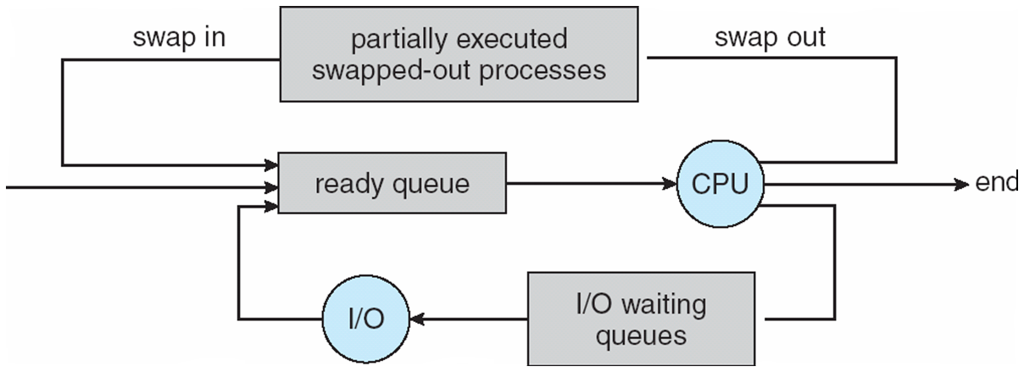
Addition of Medium Term Scheduling

Slide 10
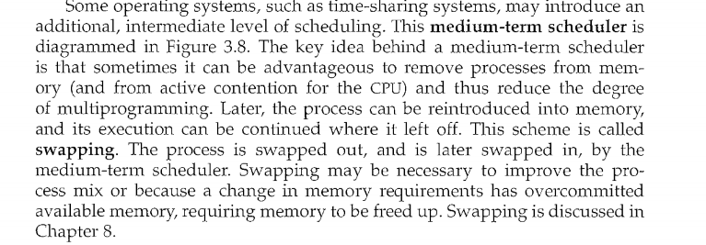

Slide 11
Context Switch
When CPU switches to another process, the system must save the state of the old process and load the saved state for the new process via a context switch.
Context of a process represented in the PCB
Context-switch time is overhead; the system does no useful work while switching
The more complex the OS and the PCB -> longer the context switch
Time dependent on hardware support
Some hardware provides multiple sets of registers per CPU -> multiple contexts loaded at once

Slide 12
Operations on Process
A process may create several new processes, via a create-process system call,
during the course of execution. The creating process is called a parent process,
and the new processes are called the children of that process. Each of these
new processes may in turn create other processes, forming a tree of processes.

Slide 13
Process Creation
Parent process create children processes, which, in turn create other processes, forming a tree of processes
Generally, process identified and managed via a process identifier (pid)
Resource sharing
Parent and children share all resources
Children share subset of parent’s resources
Parent and child share no resources
Execution
Parent and children execute concurrently
Parent waits until children terminate

Slide 14
Process Creation (Cont.)
Address space
Child duplicate of parent
Child has a program loaded into it
UNIX examples
fork system call creates new process
exec system call used after a fork to replace the process’ memory space with a new program

Slide 15
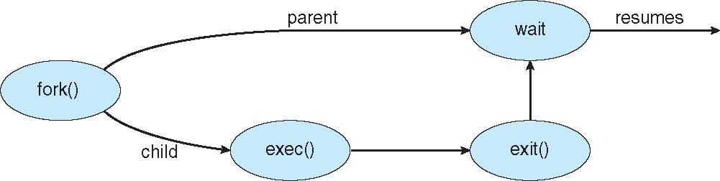
Process Creation

Slide 16
Process Termination
Process executes last statement and asks the operating system to delete it (exit)
Output data from child to parent (via wait)
Process’ resources are deallocated by operating system
Parent may terminate execution of children processes (abort)
Child has exceeded allocated resources
Task assigned to child is no longer required
If parent is exiting
Some operating systems do not allow child to continue if its parent terminates
All children terminated - cascading termination

Slide 17
Interprocess Communication
Processes within a system may be independent or cooperating
Cooperating process can affect or be affected by other processes, including sharing data
Reasons for cooperating processes:
Information sharing
Computation speedup
Modularity
Convenience
Cooperating processes need interprocess communication (IPC)
Two models of IPC
Shared memory
Message passing

Slide 18
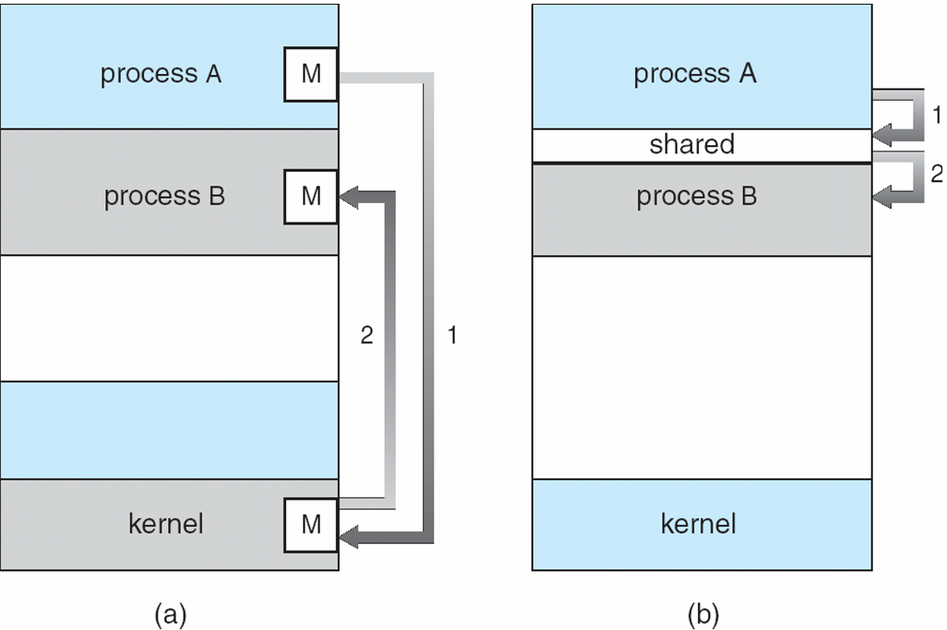
Communications Models

Slide 19
Cooperating Processes
Independent process cannot affect or be affected by the execution of another process
Cooperating process can affect or be affected by the execution of another process
Advantages of process cooperation
Information sharing
Computation speed-up
Modularity
Convenience

Slide 20
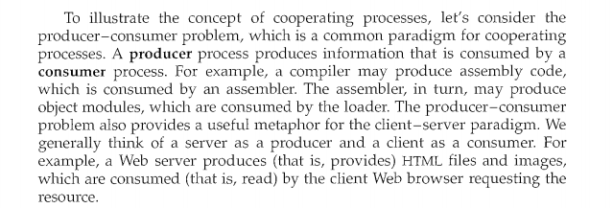
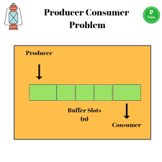

Shared-Memory Systems

Slide 21
Interprocess Communication – Message Passing
Mechanism for processes to communicate and to synchronize their actions
Message system – processes communicate with each other without resorting to shared variables
IPC facility provides two operations:
send(message) – message size fixed or variable
receive(message)
If P and Q wish to communicate, they need to:
establish a communication link between them
exchange messages via send/receive
Implementation of communication link
physical (e.g., shared memory, hardware bus)
logical (e.g., logical properties)

Slide 22
Here are several methods for logically implementing a link and the send 0 I receive() operations:
Direct or indirect communication
Synchronous or asynchronous communication
Automatic or explicit buffering

Slide 23
Direct Communication
Processes must name each other explicitly:
send (P, message) – send a message to process P
receive(Q, message) – receive a message from process Q
Properties of communication link
Links are established automatically
A link is associated with exactly one pair of communicating processes
Between each pair there exists exactly one link
The link may be unidirectional, but is usually bi-directional

Slide 24
Indirect Communication
Messages are directed and received from mailboxes (also referred to as ports)
Each mailbox has a unique id
Processes can communicate only if they share a mailbox
Properties of communication link
Link established only if processes share a common mailbox
A link may be associated with many processes
Each pair of processes may share several communication links
Link may be unidirectional or bi-directional

Slide 25
Indirect Communication
Operations
create a new mailbox
send and receive messages through mailbox
destroy a mailbox
Primitives are defined as:
send(A, message) – send a message to mailbox A
receive(A, message) – receive a message from mailbox A

Slide 26
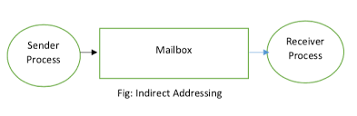
Indirect Communication
Mailbox sharing
P₁, P₂, and P₃ share mailbox A
P₁, sends; P₂ and P₃ receive
Who gets the message?
Solutions
Allow a link to be associated with at most two processes
Allow only one process at a time to execute a receive operation
Allow the system to select arbitrarily the receiver. Sender is notified who the receiver was.

Slide 27
Synchronization
Message passing may be either blocking or non-blocking
Blocking is considered synchronous
Blocking send has the sender block until the message is received
Blocking receive has the receiver block until a message is available
Non-blocking is considered asynchronous
Non-blocking send has the sender send the message and continue
Non-blocking receive has the receiver receive a valid message or null

Slide 28
Buffering
Queue of messages attached to the link; implemented in one of three ways
1. Zero capacity – 0 messages Sender must wait for receiver (rendezvous)
2. Bounded capacity – finite length of n messages Sender must wait if link full
3. Unbounded capacity – infinite length Sender never waits

